Slide 1




Seizure detection with wearable devices and AI
Dr. Christos Chatzichristos
Joint work with: Prof. M. Devos, Prof. S. Van Huffel, Prof. W. Van Paesschen, Dr. K. Vandecasteele, Dr. T. De Cooman
M. Bhagudai, Z. Zhang, J. Dan, A. Narayanan, N. Seeuws, L. Swinnen et al.
AI for Time Series, 24/02/2022

Slide 2
Content
Introduction
  Epilepsy
  Seizure monitoring
Feature-based algorithms for different types of seizures
  Absence seizures
  Focal seizures
Deep Learning - based seizure detection

Slide 3
Introduction

Slide 4
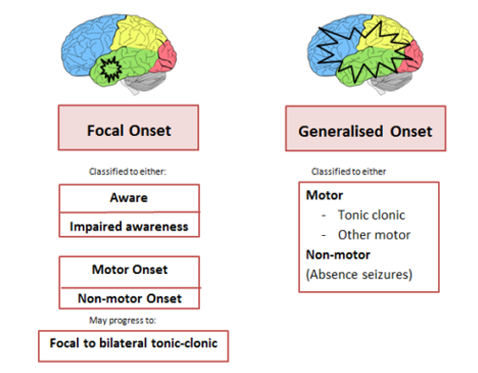
Epilepsy
Neurological disease that causes episodes of sudden irregular neuronal activation: SEIZURES

Slide 5
Epilepsy
Epilepsy diagnosis is currently done in Epilepsy Monitoring Units with video-electroencephalography:
  Time-consuming
  Expensive
  Not suitable for long-term monitoring
Outside the hospital, patients use seizure diaries:
  More than 50% of seizures are not reported

Slide 6
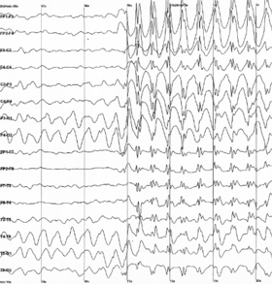
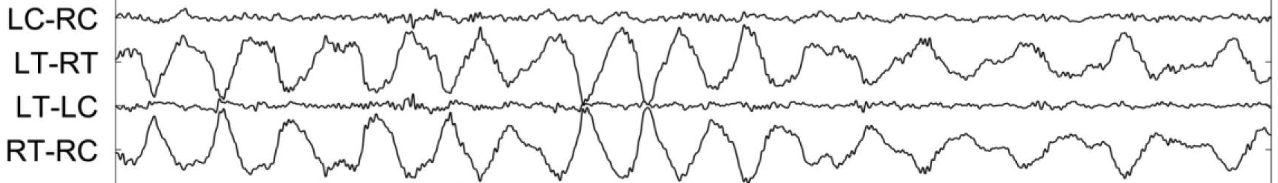
Seizure detection
Large variety of seizure types
Seizure profiles are very patient specific
Reduced data quality in wearable devices:
  Less channels
  More artifacts
There is a lack of reliability and generalisability on current seizure detection methodologies based on wearable devices

Slide 7
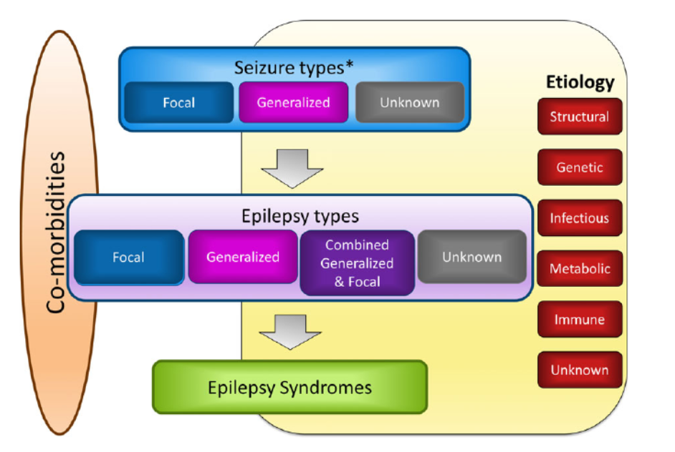
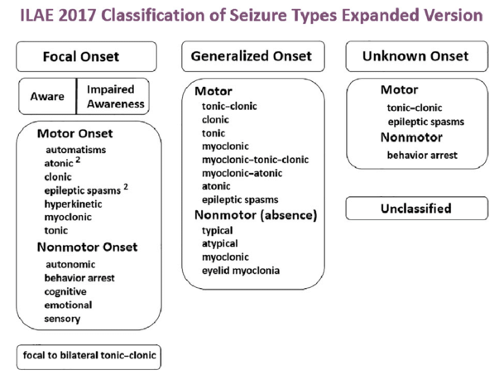
Type of seizures

Slide 8
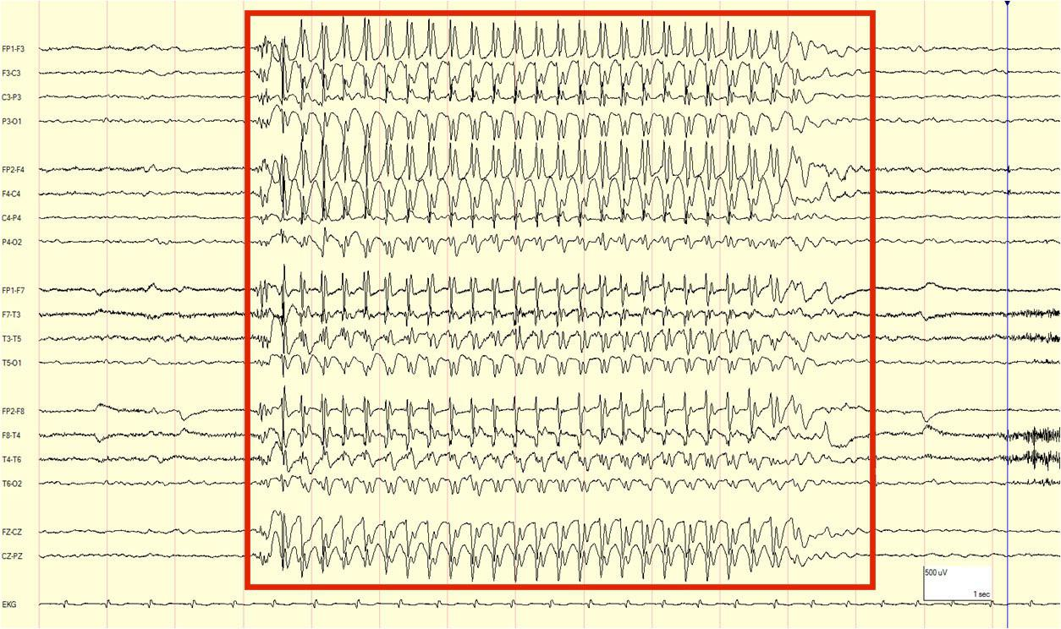
Type of seizures - absence

Slide 9
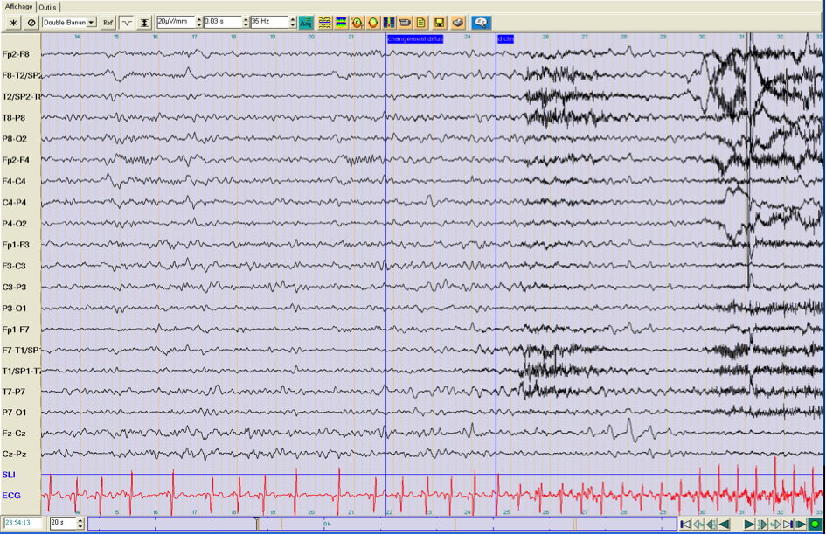
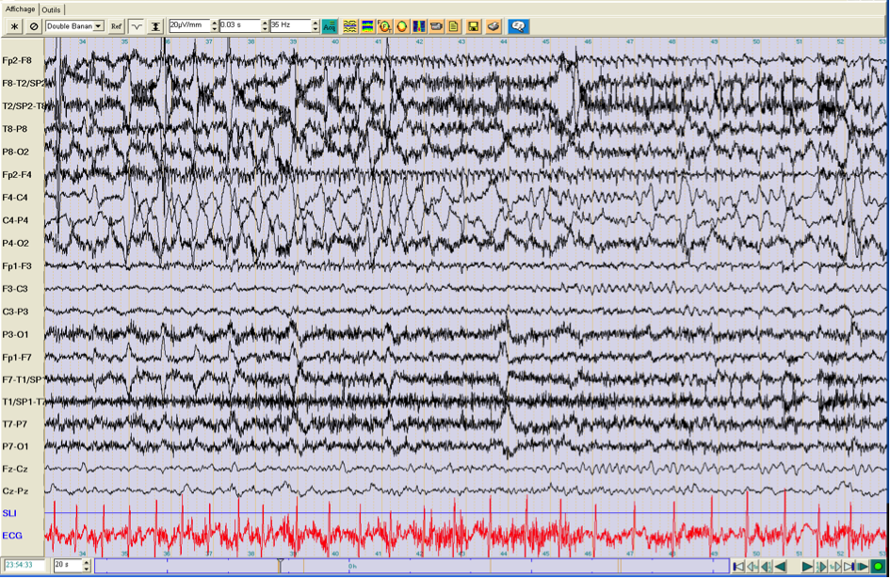
Type of seizures - focal

Slide 10
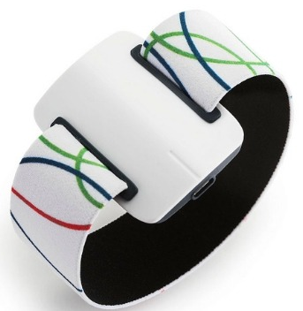
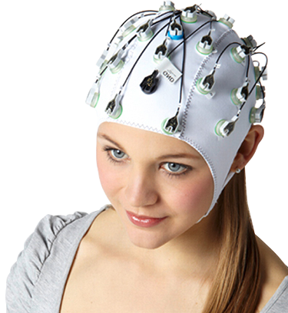
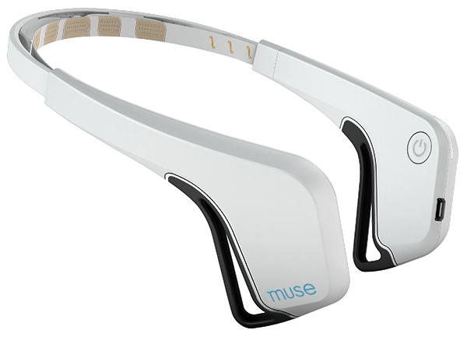
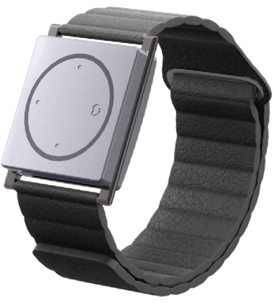
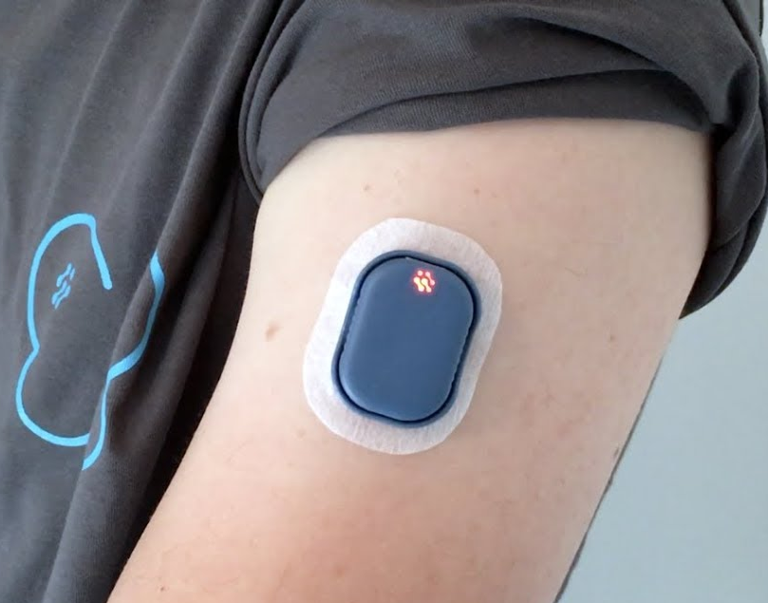
Seizure detection
Hospital monitoring
(vEEG)
Ambulatory monitoring
(ECG/PPG, ACC, EMG, EDA, wearable EEG)
Automated ambulatory seizure detection:
  Improve treatment by long-term reliable monitoring
  Alarm patients and caregivers when a seizure occurs

Slide 11
Multimodal seizure detection
Unimodal methodologies are good for specific types of seizures
A multimodal framework can combine information from different sensors that can measure other physiological changes during seizures
Wearable EEG
ECG
EMG
(most) Focal
Generalised absence
Focal (temporal lobe)
Generalised motor
Generalised motor

Slide 12

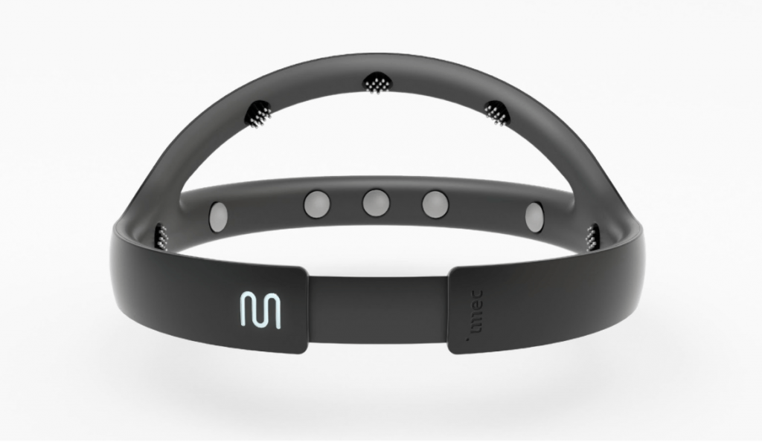
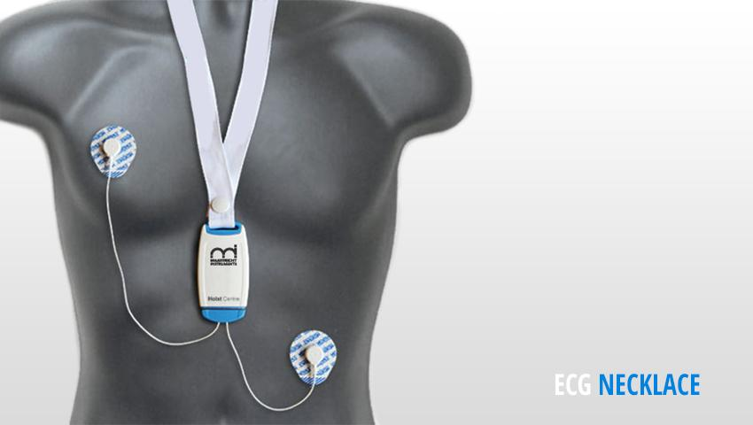

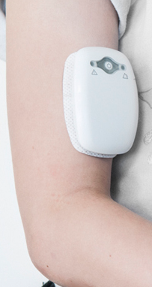
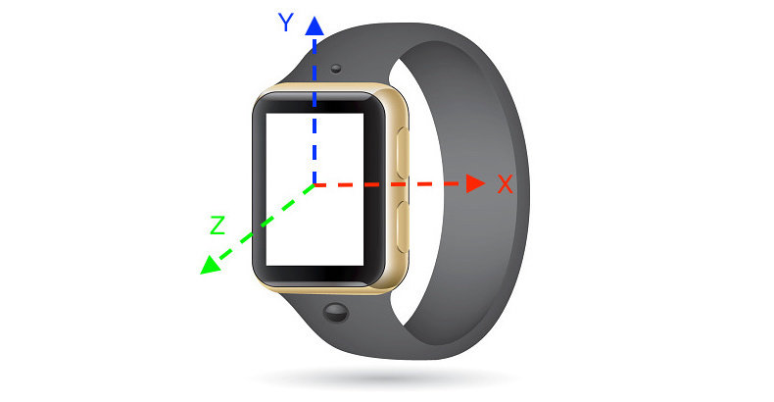



Seizure detection - diaries
Real time
Alarm
Unsupervised
personalization
EEG
Modify
medication
ECG
Feature
Extraction
Seizure segment Classification
EMG
Supervised personalization
Offline
seizure diary
ML
Seizure
diary
Accelerometer

Slide 13
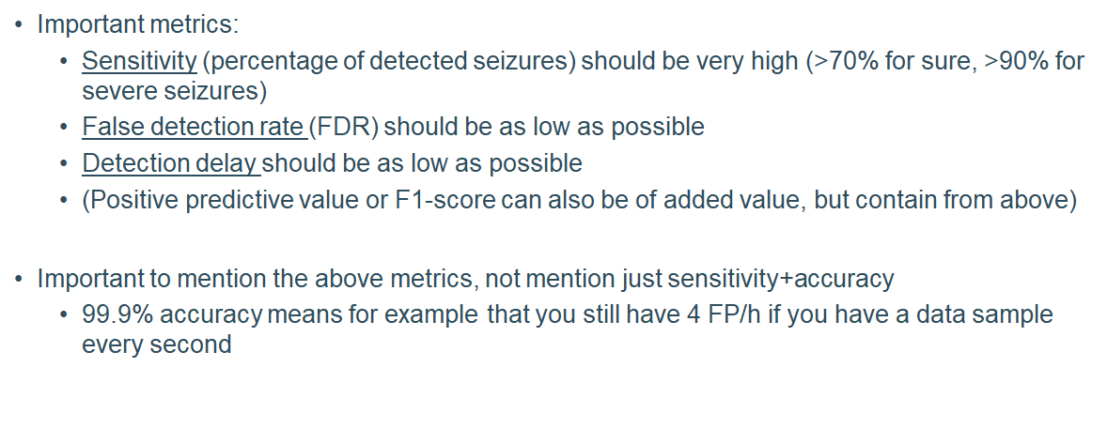
Seizure detection metrics

Slide 14
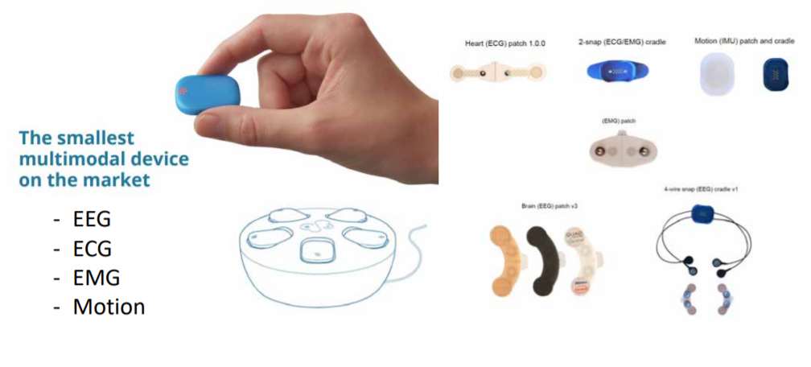

Byteflies - sensor dot: multimodal wearable

Slide 15
Wearable data recordings – SeizeIT1
Dataset containing continuous recordings with full scalp EEG and additional electrodes placed behind the ear (BHE)
Contains mostly temporal lobe focal seizures (focal impaired awareness, focal aware and focal to bilateral tonic-clonic seizures)
Number of Patients | 42
Number of Seizures | 182
Seizures duration | 3.3 hours
Non-seizure duration | 1337.3 hours

Slide 16
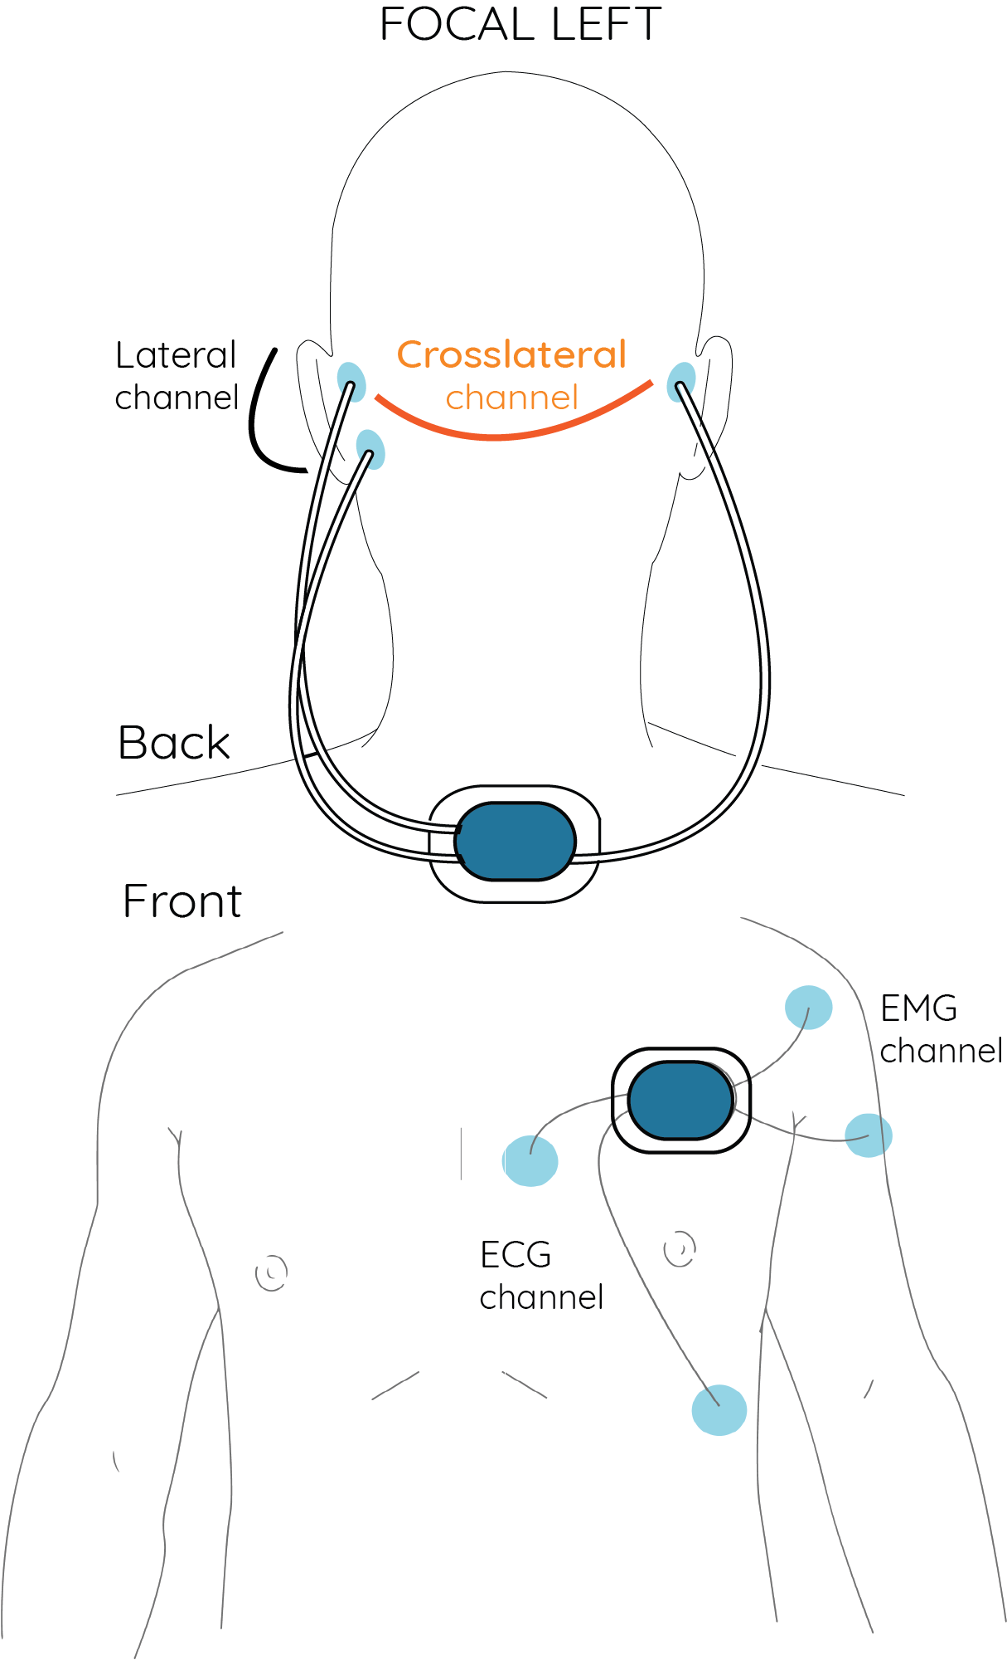
Wearable data recordings – SeizeIT2
Device developed within the SeizeIT2 project: Byteflies Sensor Dot (SD)
Measurement of multiple modalities:
  Behind-the-ear (BHE) EEG
  ECG
  EMG
Goal to record 500 patients in hospital
Selected patients for longitudinal at-home recording

Slide 17
Feature-based algorithms for different types of seizures

Slide 18
Absence seizures - EEG based seizure detection
N= 12
Median age: 20 years (9‐50)
Gender: 7 women, 5 men •
Median age at epilepsy: 9 years (6‐22)
Epilepsy syndrome:
– Juvenile absence epilepsy: n=8
– Childhood absence epilepsy: n=2
– Juvenile myoclonic epilepsy: n=2
Absences: defined as 3 Hz spike and wave discharge lasting ≥ 3 seconds: n= 284
 | Sensor-Dot | Self diary
Sensitivity | 0.83 | 0.08
Positive predictive value | 89% | 100%
F1-score | 0.87 | 0.15
[1] Swinnen L, Chatzichristos, C. Jansen K. Et al. (2021). Accurate detection of typical absence seizures in adults and children using a two-channel electroencephalographic wearable behind the ears

Slide 19
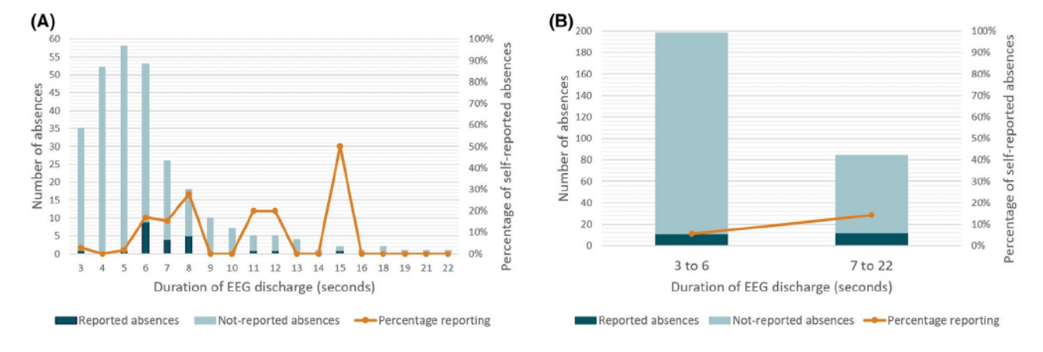
Absence seizures - EEG based seizure detection
Percentage of seizures (defined in this study as a discharge lasting 3s or longer) of different duration reported by the
patients themselves or by caregivers for children. (A) Each duration separately. (B) Grouped into shorter and longer duration

Slide 20
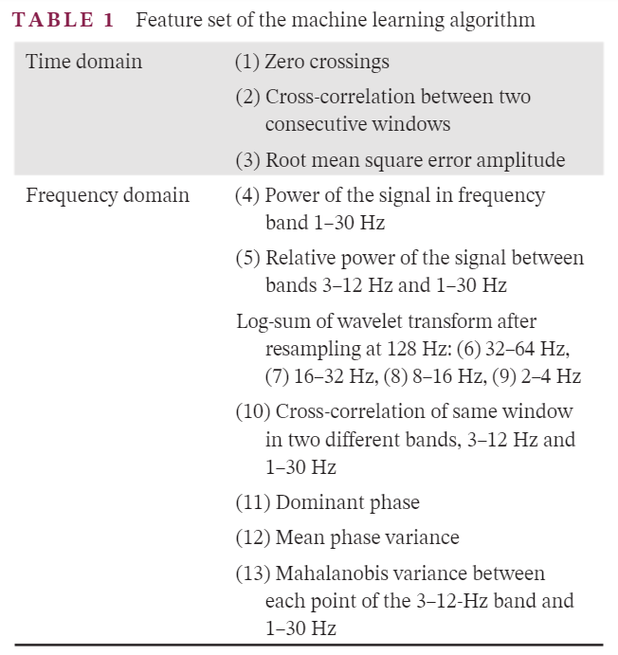
Absence seizures - EEG based seizure detection
Personalized semi-automatic seizure detection algorithm for detecting absences on SD EEG.
Subsampling with k-means for balancing classes
Each SD channel bandpass filtered (1–25 Hz).
Data were segmented in 2-s windows with 50% overlap and features were calculated for each.
Post-processing: when two seizures (of three windows each) were separated only by one non-seizure window, they were merged.
 | Sensitivity | Fps/h
Kjaer [2] | 0.9503 | 3.1281
Proposed | 0.9967 | 2.3929
Proposed + post process | 0.983 | 0.9183
[2] Kjaer TW, Sorensen HBD, Groenborg S, et al. Detection of paroxysms in long-term, single-channel EEG-monitoring of patients with typical absence seizures. IEEE J Transl Eng Heal Med. 2017;5(2000):1–8.

Slide 21
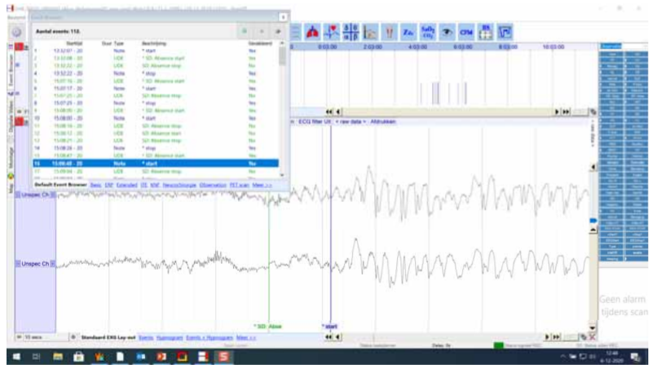
Absence seizures - EEG based seizure detection
Time to read 24 hour Sensor-Dot EEG: 1-2 hours
Patient-specific algorithm to automatic detect absences with sensitivity higher than 98%
Time to read 24 hour Sensor-Dot EEG: median minutes (range 1-20)

Slide 22
Focal seizures - EEG based seizure detection
Many studies focus on full scalp EEG seizure detection
  Large variety of datasets does not allow for a fair comparison of methodologies
BHE EEG seizure detection [3]:
  SeizeIT1 dataset
  Feature based SVM
classifier
 | Sensitivity | FA/24h | F1-score
Patient-independent | 72.7% | 34.2 | 0.16
Patient-specific | 63.4% | 0.88 | 0.57
[3] Vandecasteele, K., De Cooman, T., Dan, J., Cleeren, E., Van Huffel, S., Hunyadi, B., & Van Paesschen, W. (2020). Visual seizure annotation and automated seizure detection using behind-the-ear electroencephalographic channels. Epilepsia, 61(4), 766–775.

Slide 23
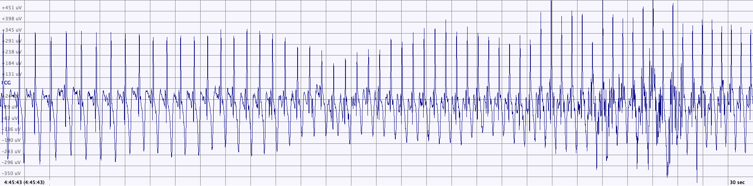
Focal seizures - ECG based seizure detection
Seizures can cause changes in the autonomic nervous system:
  Heart-rate variations can be used to detect epileptic events [3]
 | Sensitivity | FA/h
ECG HRI-SVM [4] | 65% | 1.00
[4] De Cooman, T., Varon, C., Hunyadi, B., Van Paesschen, W., Lagae, L., & Van Huffel, S. (2017). Online Automated Seizure Detection in Temporal Lobe Epilepsy Patients Using Single-lead ECG. International journal of neural systems, 27(7), 175002

Slide 24
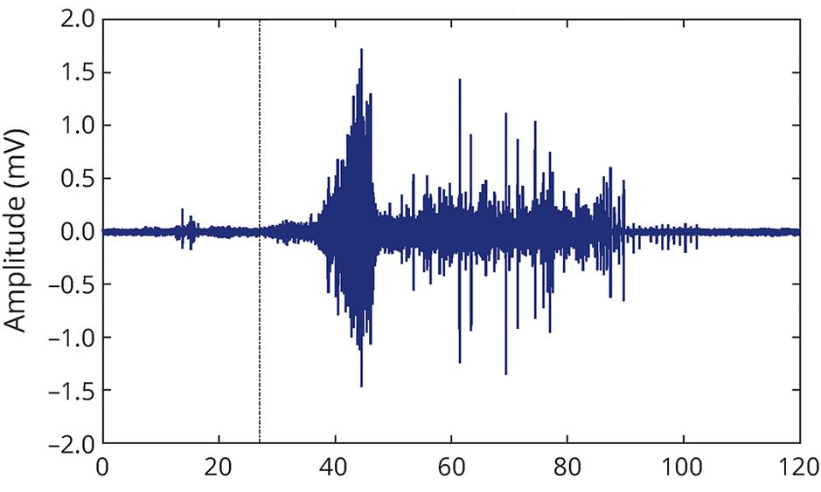
Focal seizures - EMG based seizure detection
Tonic (-clonic) seizures cause strong stiffening and/or motor movements
Feature-based methodologies have shown good sensitivity for seizure detection based on muscle activity [5-6]
 | Sensitivity | FA/24h
EMG TD feat [4] | 93.8% | 0.67
EMG TD + Entropy feat [5] | 81.8% | 0.60
[5] Beniczky, S., Conradsen, I., Henning, O., Fabricius, M., & Wolf, P. (2018). Automated real-time detection of tonic-clonic seizures using a wearable EMG device. Neurology, 90(5), e428–e434.
[6] Milosevic M, Van de Vel A, Bonroy B, et al. (2016) Automated Detection of Tonic-Clonic Seizures Using 3-D Accelerometry and Surface Electromyography in Paediatric Patients. IEEE J Biomed Health Inform. 20(5), 1333-1341

Slide 25
Focal seizures. Multimodal seizure detection
Improve classification performance by integrating modalities that capture different physiological changes caused by seizures
Multimodal full-scalp EEG + EMG + ECG explored with simple OR methodologies [8]
 | Sensitivity | FA/24h
EEG [7] | 68% | 4.2
EEG+ECG+EMG [7] | 74% | 6.0
 | Sensitivity | FA/24h
EEG [8] | 81% | 1.85
EEG+ECG [8] | 92% | 1.85
[7] Fürbass F., et al. (2017) "Automatic multimodal detection for long-term seizure documentation in epilepsy." Clinical Neurophysiology 128.8, 1466-1472.
[8] Vandecasteele K., et al. The power of ECG in multimodal patient-specific seizure monitoring: Added value to an EEG-based detector using limited channels. Epilepsia. 2021; 62: 2333– 2343.

Slide 26
Deep Learning – based seizure detection

Slide 27
Architectures
Fully Convolutional Network (FCN) [9]
1D Convolutional Neural Network (CNN1D) [10]
Shallow Convolutional Neural Network (ShallowConvNet) [11]
Deep Convolutional Neural Network (DeepConvNet) [11]
U-net [12]
ChronoNet (CNN + RNN) [13]
[9] Alison O’Shea, et al. (2020), Neonatal seizure detection from raw multi-channel EEG using a fully convolutional architecture, Neural Networks, Volume 123
[10] Ihsan Ullah, et al. (2018), An automated system for epilepsy detection using EEG brain signals based on deep learning approach, Expert Systems with Applications, Volume 107, Pages 61-71, ISSN 0957-4174.
[11] Schirrmeister, R.T., et al. (2017), Deep learning with convolutional neural networks for EEG decoding and visualization. Hum. Brain Mapp., 38: 5391-5420.
[12] Chatzichristos, C, et al. (2020). Epileptic Seizure Detection in EEG via Fusion of Multi-View Attention-Gated U-net Deep Neural Networks. In Proceedings of the IEEE Signal Processing in Medicine and Biology Symposium (SPMB) (p. 7).
[13] Roy, S., et al. (2019). ChronoNet: a deep recurrent neural network for abnormal EEG identification. In Conference on Artificial Intelligence in Medicine in Europe (pp. 47-56). Springer, Cham.

Slide 28
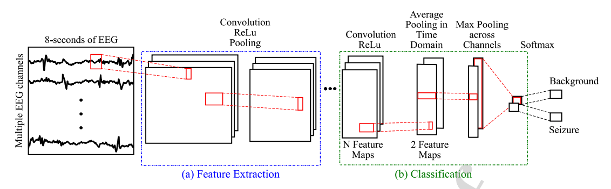
FCN
  2 feature extraction blocks:
    3 convolutions, batch normalization and average pooling
  Classification block:
    Convolution layer where number of filters = number of classes

Slide 29
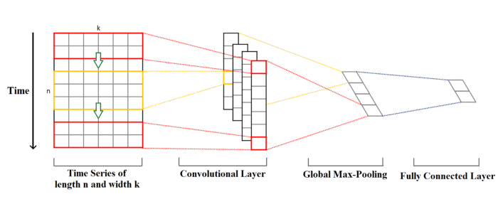
1D CNN
1 dimensional convolution (over time domain)
Classification with fully connected layer

Slide 30
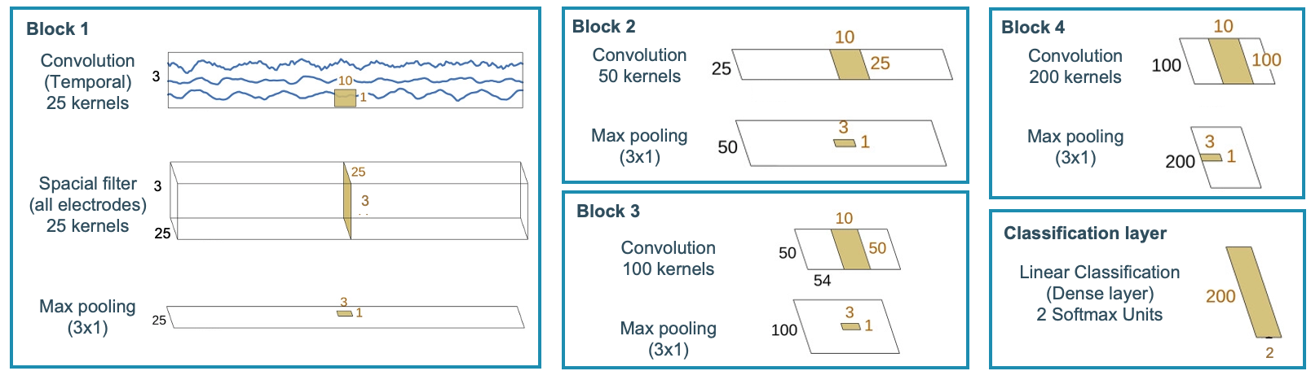
Swallow and Deep CNN
Shallow CNN contains only convolution blocks 1 and 2
Deep CNN contains all convolution blocks

Slide 31
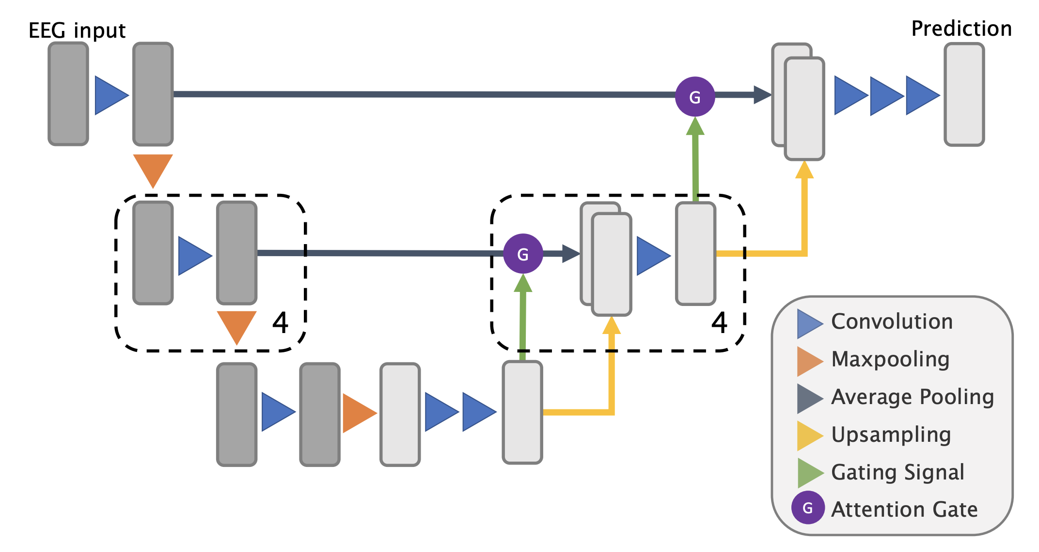
U-net
All convolutions operate along the temporal axis
  The “downward path” extracts information on different scales. It uses a maxpooling operation to down-sample the data
  The “upward path” combines local and global information before outputting a signal.
The local information of channels is merged using the Attention Gating mechanism

Slide 32
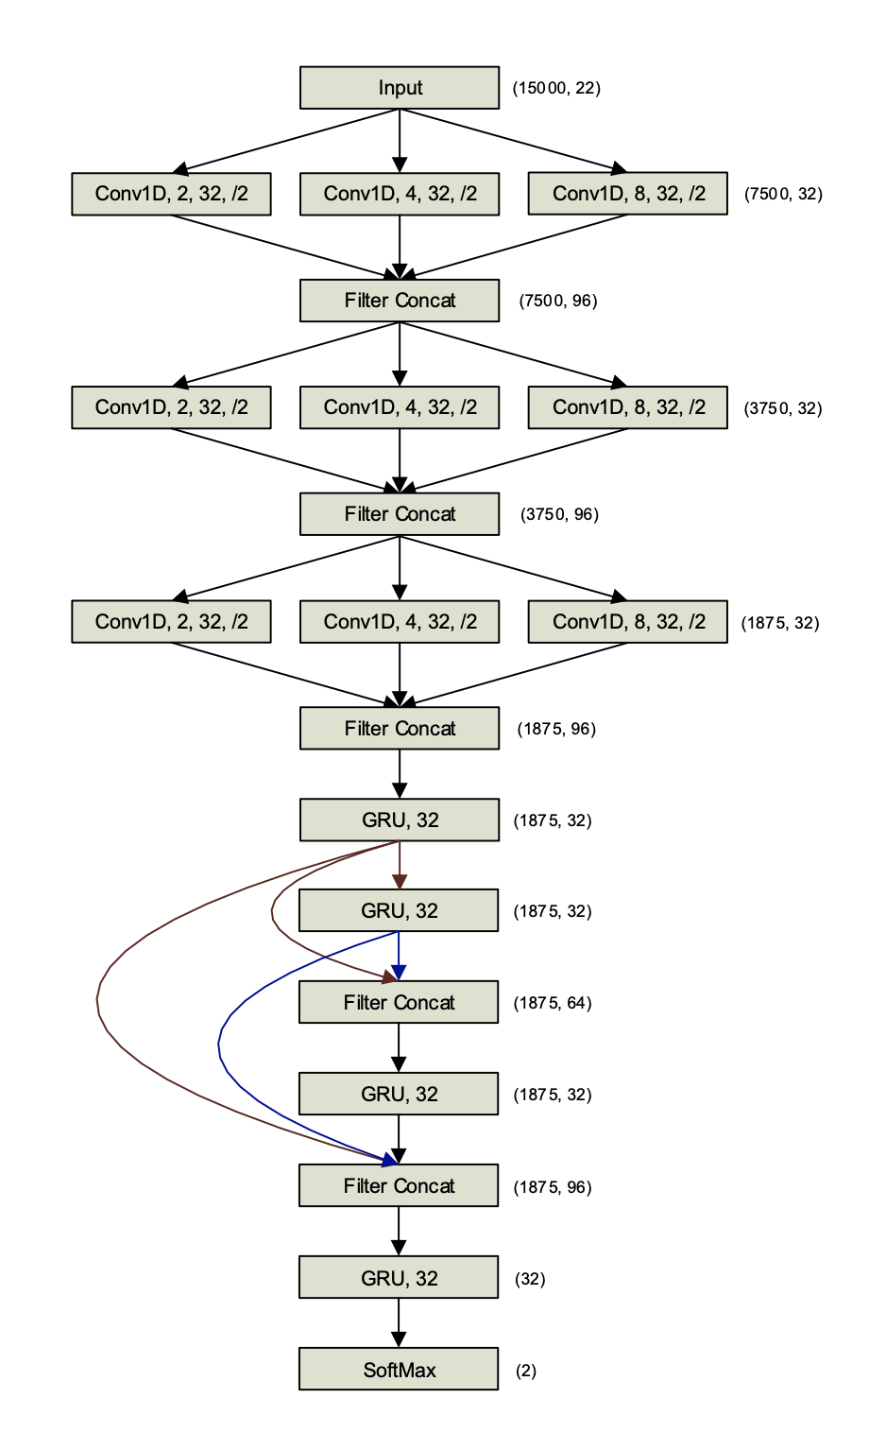
ChronoNet
Inception modules:
  Multiple filters of exponentially varying lengths in the 1D convolution layers
Dense module:
  Gated recurrent units with dense connections

Slide 33
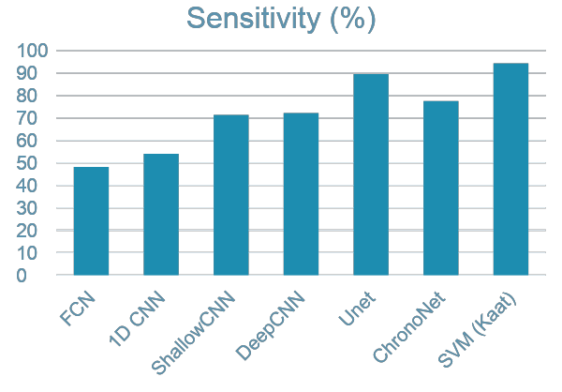
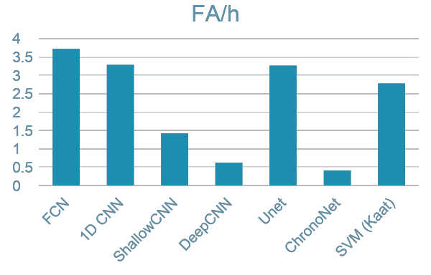
SeizeIT1 BHE results
Model | Sens | FA/h | FA/24h
FCN | 48,23 | 3,72 | 89,28
1D CNN | 54,02 | 3,29 | 78,96
ShallowCNN | 71,43 | 1,42 | 34,11
DeepCNN | 72,21 | 0,62 | 14,98
Unet | 89,58 | 3,27 | 78,53
ChronoNet | 77,57 | 0,41 | 9,84
SVM [3] | 94,32 | 2,78 | 66,62
[3] Vandecasteele, K., De Cooman, T., Dan, J., Cleeren, E., Van Huffel, S., Hunyadi, B., & Van Paesschen, W. (2020). Visual seizure annotation and automated seizure detection using behind-the-ear electroencephalographic channels. Epilepsia, 61(4), 766–775.

Slide 34
Neureka challenge

Slide 35

Neureka challenge
Neureka Challenge: An international seizure detection challenge organized by Novella Neurotech and NeuroTechX
Build a seizure detection model based on the TUH EEG Seizure database (> 3000 seizures, > 600 patients, > 6000 recordings, ~700 hours of data)
Approximately 1.5 months to train, validate and submit results
The model that performs the best in terms of the challenge’s scoring system
wins. Sensitivity and FAs are counted with Time-Aligned Event Scoring (TAES)

Slide 36
Multi-view fusion of attention-gated U-nets
EEG-data (band-pass filtered)
LSTM Fusion
Matched-filtering
U-Net
ICLabel
U-Net
Post-processing rules
Seizure labels
U-Net
Multi-view approach: Plug-and-play seizure detection framework
  Allows addition of new pre-processing framework
  Expandable and easily modifiable
U-Nets as a deep-neural network architecture for time series segmentation
Moving away from a window-based approach for seizure detection with U-Nets

Slide 37
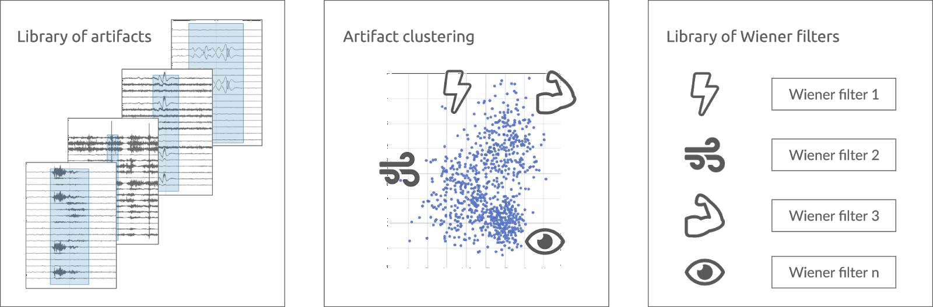
Pre-processing: Multi-channel Matched filtering
Matched-filter based artifact removal

Slide 38
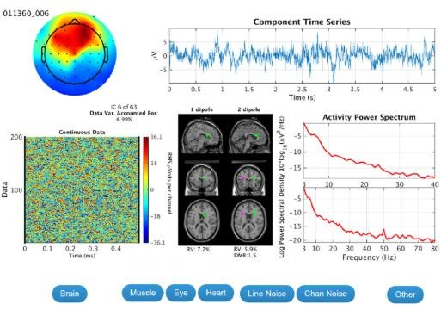
Pre-processing: IClabel
Reject bad channels
Run SOBI ICA
Classify components 4.Remove artifacts

Slide 39
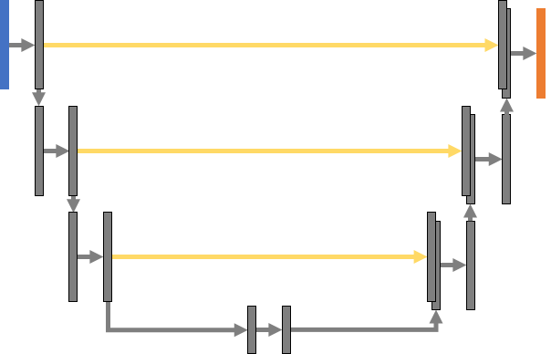

Main classification: Attention gates
Classification <-> Segmentation
Inspired by biomedical imaging
Facilitates the merge of local and global information
Prediction for each time sample
-> Results at 200Hz
Attention gates are used to attenuate the network
to meaningful local information

Slide 40
Late fusion: Recurrent NN (LSTM)
U-Net 1
U-Net 2
U-Net 3
State_t-1
State_t
State_t+1
LSTM
Fused prediction

Slide 41
Post processing
If S_{i+1} – S_{i} < 30s : Merge S_{i} and S_{i+1} ; S_{i+1} ,S_{i} are two successive seizure events
Prob(S_{i}) is a Seizure = mean (probabilities of all time points in S_{i})
Prob(S_{i} < 0.82) is rejected as a seizure
If duration of S_{i} < 15, seizure event rejected

Slide 42
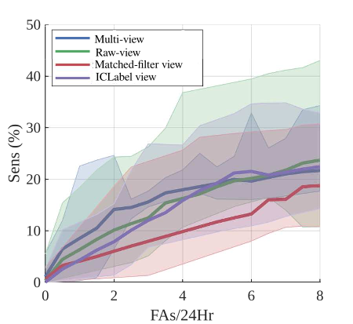
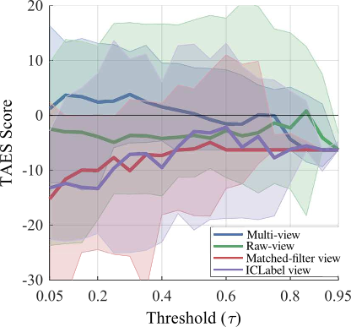
Results: Validation set
Cross-validation results: TAES performance using multi-view and other views
Cross-validation results: ROC curves using multi-view and other views
[12] Chatzichristos, C. et al. (2020). Epileptic Seizure Detection in EEG via Fusion of Multi-View Attention-Gated U-net Deep Neural Networks. In Proceedings of the IEEE Signal Processing in Medicine and Biology Symposium (SPMB) (p. 7). Best Paper Award

Slide 43
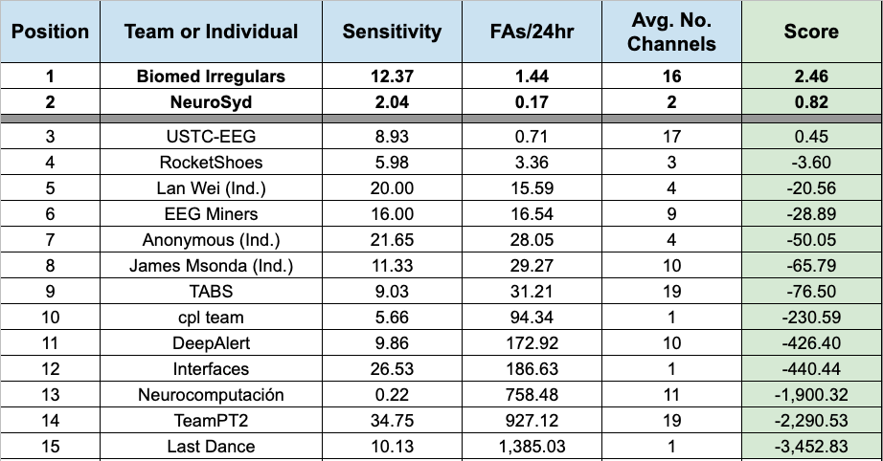
Results: Neureka Challenge leaderboard

Slide 44
Trust-scores

Slide 45
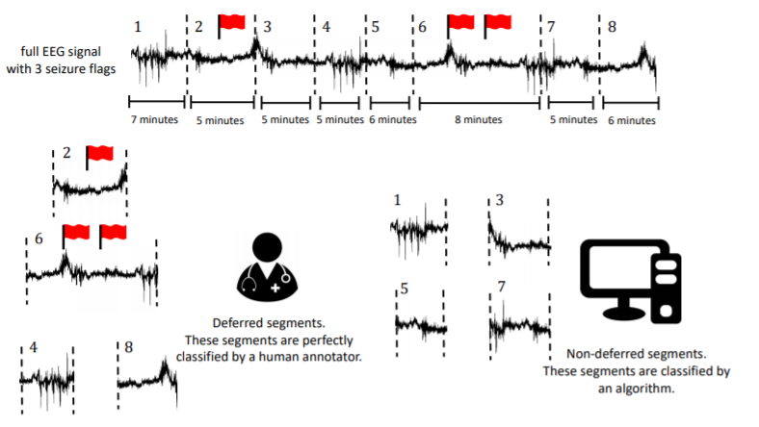
Epilepsy monitoring: Trust scores
Prediction confidence determined by temperature scaling of the classification model outputs and trust scores
The part of the data with lowest confidence are deferred to human expert for an (almost perfect) seizure detection
First time this set-up has been investigated for seizure detection.
Could lead to:
faster implementation in the clinic
more trustworthy implementation
[14] T. Becker et al “Classification with a Deferral Option and Low-Trust Filtering for Automated Seizure Detection” , Sensors, Feb. 2021

Slide 46
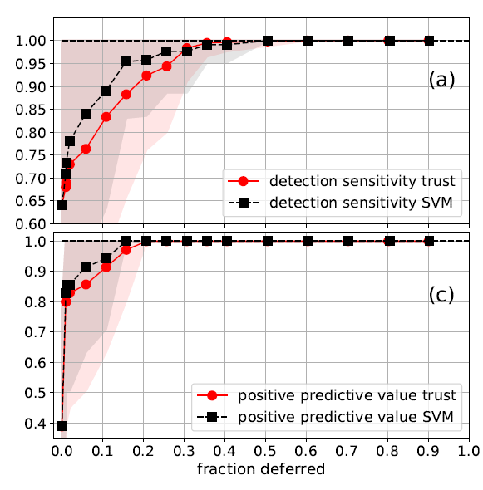
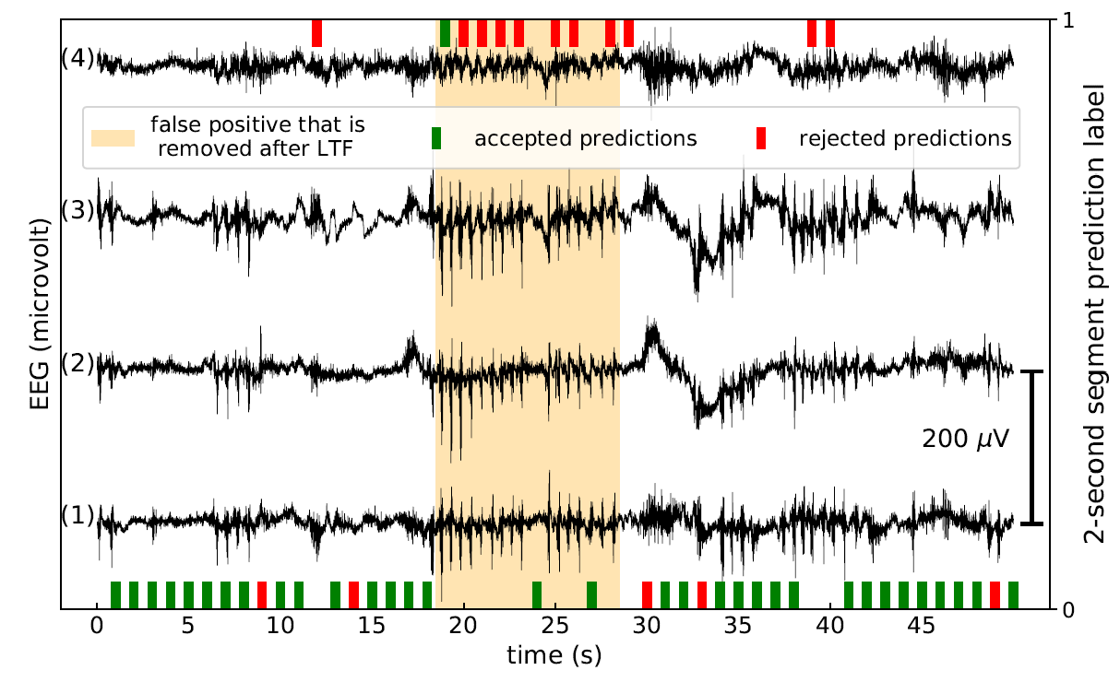
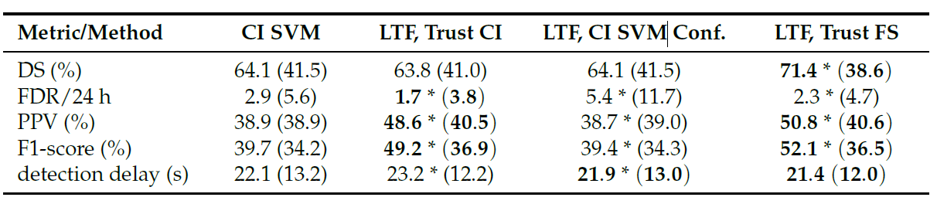
Epilepsy monitoring: Trust scores
Low-trust filtering (LTF):
discard untrustworthy predictions.
Significant improvement compared to state of the art.

Slide 47
Data quality enhancement

Slide 48
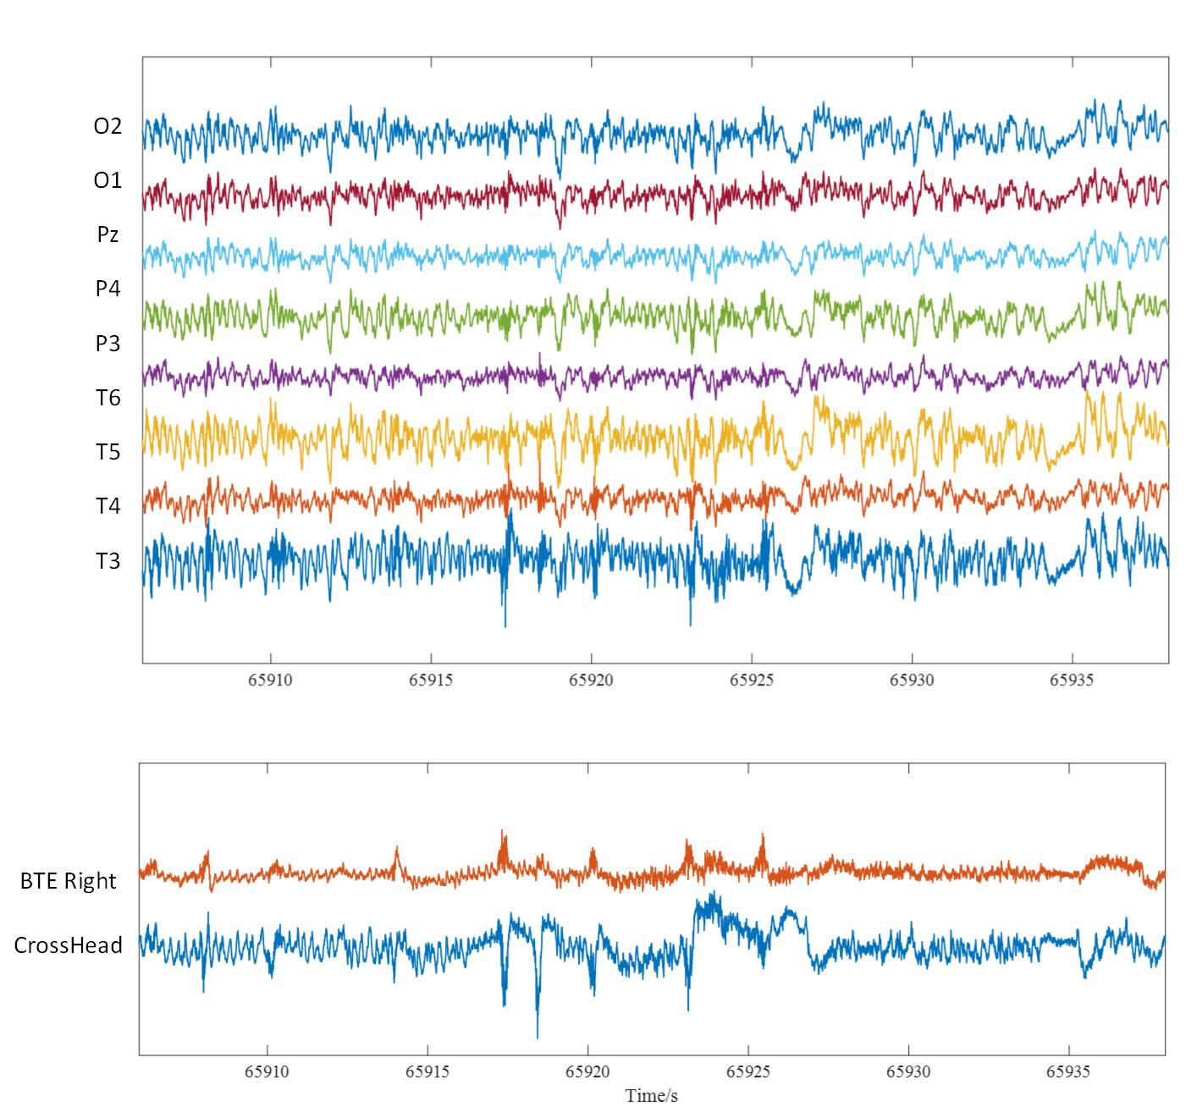
Reduced data quality: shorter visible seizure segment
Artifacts in behind-the-ear (BTE) channels:
  Occur more frequently
  Affect both BTE channels
  Corrupt the ictal seizure pattern
BTE EEG data is not perfect for training models
Submerged in artifacts!
A seizure in BTE EEG and corresponding full EEG

Slide 49
Annotations from full scalp EEG
: visible seizure segment
Scalp vEEG recording with annotation
Behind ear vEEG recording
SD EEG recording
Submerged by artifacts
SD EMG recording
Seizure pattern start later than EEG.
Annotated as a seizure
  Inaccurate annotations for the wearable data!

Slide 50
Remove inaccurately annotated segments
Manually
Automatically
Conducted by neurologist
Expensive and time consuming
Focus on clinical meaning
Conducted by algorithmically approach
Flexible and time saving
Focus on machine learning performance

Slide 51
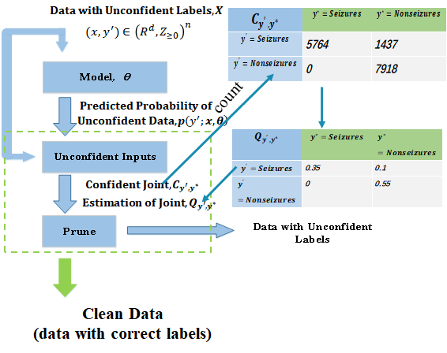
Automatic approach
Uncertainty estimation for labels - Learning with inaccurate annotations
Training Set: SeizeIT1
BHE channels
mostly focal seizures
42 patients
Test Set: SeizeIT2
Sensor Dot recordings
All focal seizures
39 adults
Annotations | Sens (%) | FA/h
Full scalp annotations | 85,4 | 6,32
Manually adapted annotations | 86,3 | 2,31
Automatically adapted annotations | 87,5 | 1,93
[15] J. Zhan et al. Automatic annotation correction for wearable EEG based epileptic seizure detection, J. Neural Engineering, Feb. 2022, 19 (1)

Slide 52
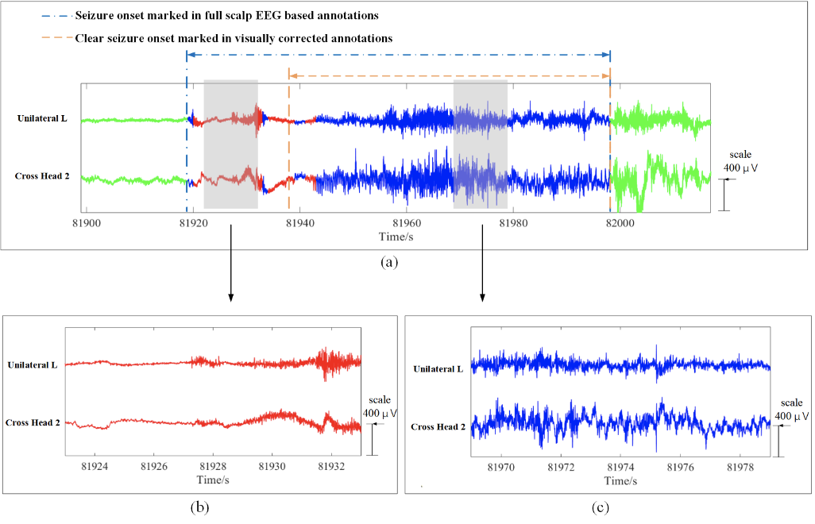
Visualization of different annotations
Chain line: seizure onset marked in full scalp EEG based annotations. Dash line: seizure onset marked in visually corrected annotations. Red: seizure sub-segments marked as incorrectly annotated by automatic approach. Blue: seizure sub-segments marked as correctly annotated by automatic approach. Green: non-seizure sub-segments. (b) zoom in on incorrectly annotated sub-segments. (c) zoom in on correctly annotated sub-segments.

Slide 53
Future research directions

Slide 54
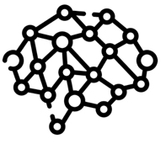
Transfer learning
Use weights from full-scalp EEG based models on the BHE EEG model training
Full-scalp EEG
BHE EEG
Seizure
detection

Slide 55
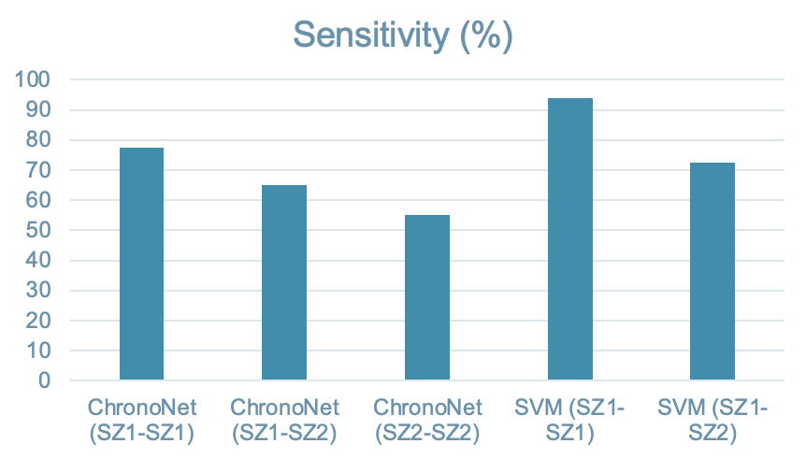
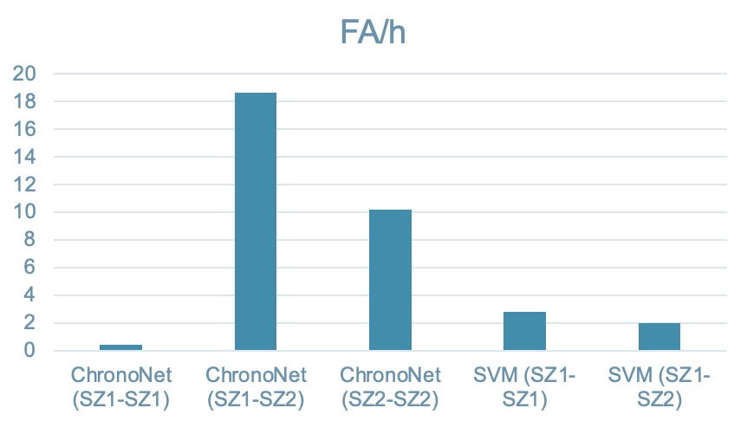
SeizeIT2 BHE results
Model | Train data | Test data | Sens | FA/h | FA/24h
ChronoNet | SZ1 | SZ1 | 77,57 | 0,41 | 9,84
 | SZ1 | SZ2 | 65 | 18,63 | 447,12
 | SZ2 | SZ2 | 55 | 10,21 | 245,04
SVM | SZ1 | SZ1 | 94 | 2,78 | 66,62
 | SZ1 | SZ2 | 72,6 | 1,97 | 47,28

Slide 56
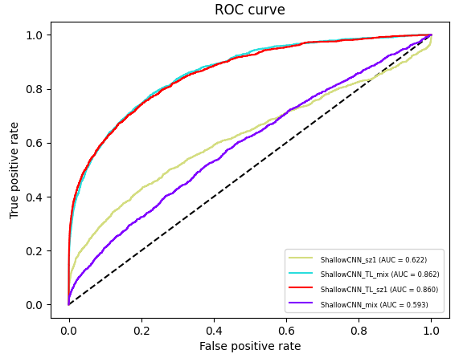
SeizeIT1 BHE results - Transfer Learning
 | AUC | Sens | FA/h | F1
ShallowCNN BHE | 0,622 | 0,52 | 2,50 | 0,511
ShallowCNN BHE mix | 0,593 | 0,56 | 9,21 | 0,531
TL (sz1>sz1) | 0,860 | 0,82 | 1,71 | 0,623
TL (mix>sz1) | 0,860 | 0,80 | 1,56 | 0,617

Slide 57
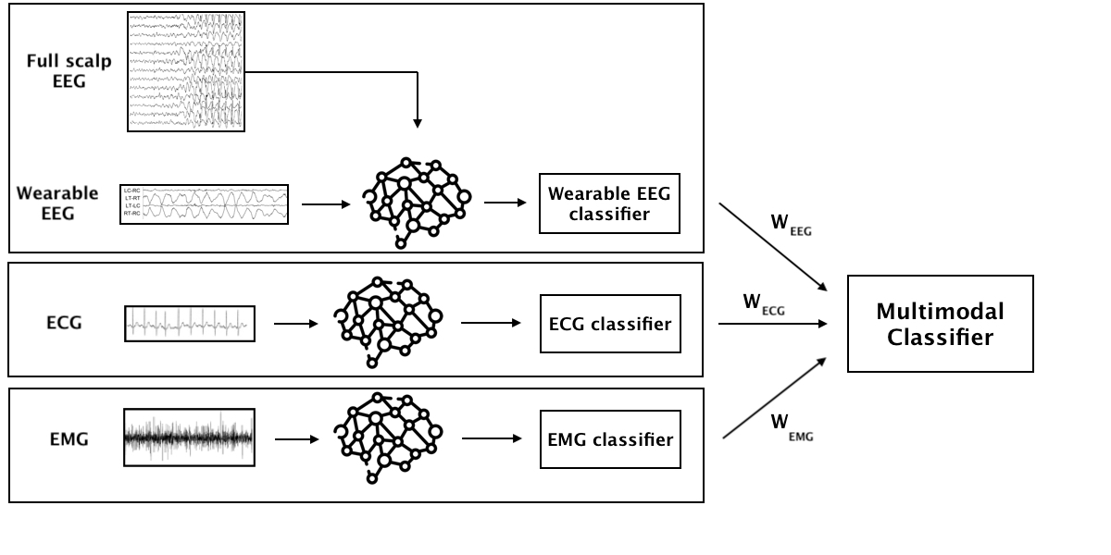

Multimodal seizure detection
Late integration
Early integration
Input composed by aggregation of different signals
Multimodal transformer [13]:
  Cross modality attention modules merging low-level features of different modalities
Ensemble learning:
  Weighted combination of each model’s output
[16] Tsai, Y. H. H., et a. (2019). Multimodal transformer for unaligned multimodal language sequences. In Proceedings of the conference. Association for Computational Linguistics. Meeting (Vol. 2019, p. 6558)

Slide 58


Anomaly detection
Separate clean and artifactual data by identifying out-of-distribution cases in the late representation space of the signal features
  Implement anomaly penalisation parameters in the training process [14]
High
Anomaly score
Low
Reenforce anomaly penalisation by using labelled artifacts and misclassifications produced by the model
[17] Ruff, L., Vandermeulen, R. A., Görnitz, N., Binder, A., Müller, E., Müller, K. R., & Klof, M. (2019). Deep semi-supervised anomaly detection. arXiv preprint arXiv:1906.02694

Slide 59

Semi-supervised learning and personalisation
How to make use of unlabelled data recorded in the ambulatory setting?
Self-training semi-supervised learning:
Increase semi-supervised performance with pseudo-labelling and consistency regularisation techniques [15]
[18] Kihyuk Sohn, David Berthelot, Chun-Liang Li, Zizhao Zhang, Nicholas Carlini, Ekin D. Cubuk, Alex Kurakin, Han Zhang, & Colin Raffel. (2020) FixMatch: Simplifying Semi-Supervised Learning with Consistency and Confidence. In Advances in Neural Information Processing Systems 33 pre-proceedings (NeurIPS 2020).

Slide 60

Ambulatory multimodal seizure detection

Slide 61
THANK YOU VERY MUCH
QUESTIONS ?????

